Slide 1

Maze Solver
Nick Andujar, Tyler Hixon, Max Shumaker, Norman Lee, Chase Deweese

Slide 2
Progress
Backtracking completely working
Output completely working
Reference directions added
Updated menu
Colors added

Slide 3
Contributions
Nick – Backtracking and intersection + misc. functions
Max – Output and file reading
Chase – Menu/UI and nodal structure + optimization
Tyler – navigation and stack set up
Norman – Intersections and output formatting

Slide 4
Technology Stack
Github – main hub of code and checkpoint information
VSCode – main IDE used by members
Xcode – Secondary IDE used

Slide 5
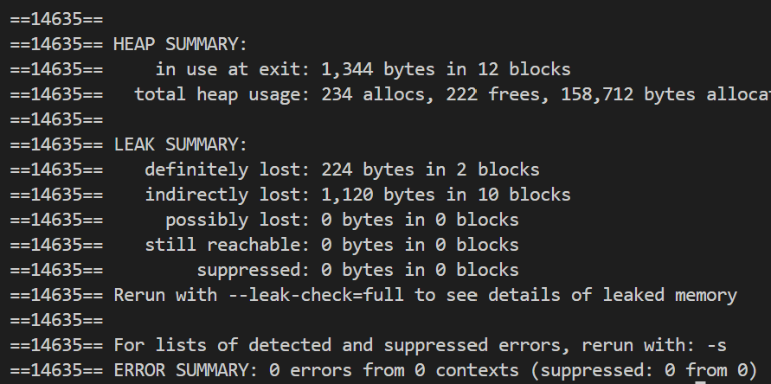
Tools used
Cppcheck - Showed us many errors
Valgrind – 1,344 bytes potentially lost

